Slide 1
SAILGRIB WR
You have to choose manually starting and ending point
You can choose the type of your boat from a list (it takes wind into account)
Calculates routing time
Whenever the app faces obstacles, it updates routing
Not bathymetric data?
Showing weather separately, not taking it under account for planning the route
Marine charts
AIS module
Navigation panel
Option to load custom charts
Tide module
Current models
2 days free of GFS forecast
1 day of tidal forecast
50 NM routing
No atlas of tidal currents
No navigation panel
No navionics charts
You can subscribe to Premium for 1 month (16 eur)/year(31 eur)/lifetime(75 eur)

Slide 2
NAVIONICS
Autorouting, electronic charts, weather display, detailed bathymetry
Sonar Chart Shading: Satellite Overlay, offers a top-down view of inland and coastal areas and SonarChart Shading, gives a unique perspective of underwater topography at a glance. Created from the high-definition contour data within SonarChart, our shading presents a detailed rendering of the seafloor and lake bottoms in varying shades blue. (++ 3D view and panoramic photos for better understanding of surroundings) – 20-60 eur per region
For mobile or for plotter
Navionics+ at 243 eur for Med and BSea

Slide 3
BOATING HD MARINE & LAKES
Perfect if you don’t have GPS on board
Relates to Navionics
Shows distance/time/consumption
Shows weather map separately
Free 15-day trial / subscription 15-50 eur per region

Slide 4
C-MAP / MARINE CHARTS
Save routes and waypoints → accessible offline
Download marine charts
Find best route
AIS data
Get weather information
Info about marinas, harbors, beaches, shops
Looks like GPS
With premium you can download maps offline / 30 eur for Greece region

Slide 5
STORMGEO ROUTING
For commercial shipping → route analysts contact captain for safe and efficient routing

Slide 6
PREDICT WIND
Compares 4 different weather forecast models
50 km resolution with better one available for specific areas
Provides best routing based on weather forecast and boat characteristics
Offline option

Slide 7
Weather routing packages
5 weather routeing packages tested
PredictWind
Professional subscription available online or via a PredictWind Offshore app for mobile platforms. The subscription price is from $399 per year for the standard version.
SailGrib WR
An Android-based app that currently costs just £35 for an indefinite licence.
Expedition
Software package costing US$1,295 (£901). Its Tidal Atlas for North Western Europe is an extra £175.
Squid
Free software package that can be downloaded to a Windows PC or the Squid mobile app for tablets/phones. I tested the racing CEP 0.125 subscription. Hi Res packages cost €69 per year for the Mediterranean Sea or €299 for the world.
MaxSea Time Zero v2.0
I tested the TZ Navigator pack with advanced routeing and current charts for the UK and Ireland, which costs £859.

Slide 8
WHAT WE OFFER
Routing based on
Bathymetry (10m resolution)
Seabed classification for anchorage information (way tba)
Routing (try real time)
Weather prediction (resolution 4 km plus API resolution tba ) and real time display (save consumption)
For commercial use: ice watch, pollution tracker, piracy watch, extra layer ECDIS
Include beach reviews + plastic and chla tracking
Target market - Pricing
Purpose of the app? Targeted customers/region? Yachts/Mediterranean?
Cost of the app? Maybe cost/benefit analysis?

Slide 9
Pricing strategies
Free: The free apps are completely free to download in the app store, where their main source of income comes from advertisements. However, free apps are created by companies that are creating a product or service extension of what they offer. Free apps are meant to serve as a tool for customer retention, communication, customer service and other related things.
Freemium: These apps are free to download, but will have limited functionality and features. Companies started creating apps with in-app purchases, allowing developers to charge for extra features. Customers can pay more money within the app to open the features or speedup the game play, which eventually increases the value of the app.
Paid: As the name says – the users are asked to pay once for the app to download and use it. However, these apps have decreased popularity over years, due to the increasing number of free and freemium apps. Purchasing the app for one time is one of the common pricing strategies. However, according to the experts of reputed mobile app development companies —- it is the least effective approach. Paid is still a powerful pricing strategy for certain apps.
Paidmium: These apps are mixture of paid and freemium models, where users are asked to pay for the app, but have option to unlock additional features by paying more. Paidmium is not yet a powerful pricing strategy, but it has the potential to unlock new revenue streams. Paidmium may work well for music apps, social networking and navigation apps. Though this pricing strategy forces you to provide reasons for the users to make purchase, it can help you generate ongoing revenue.

Slide 10
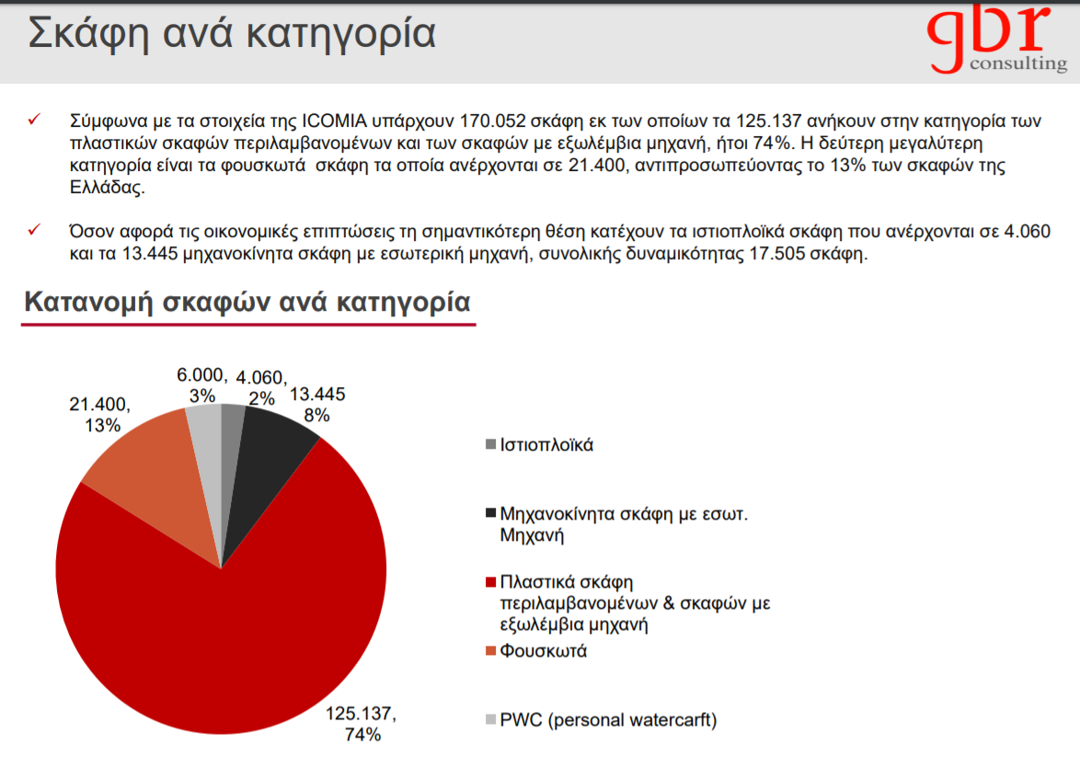

Slide 11
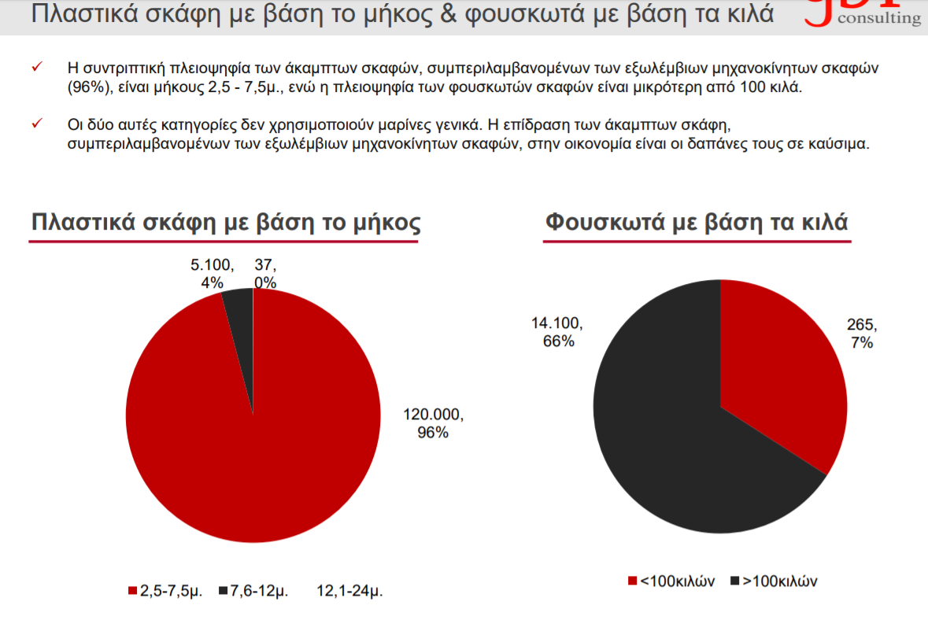

Slide 12
